Slide 1
Employee Data Analysis using Excel
STUDENT NAME: S.P.LAKSHMI PRIYA
REGISTER NO: 312200857
DEPARTMENT:B.COM(General)3rd year
COLLEGE Pachaiyappa’s college for women

Slide 2
PROJECT TITLE
Employee Data Analysis using Excel

Slide 3


AGENDA
Problem Statement
Project Overview
End Users
Our Solution and Proposition
Dataset Description
Modelling Approach
Results and Discussion
Conclusion
3/21/2024 Annual Review

Slide 4

PROBLEM STATEMENT
Incomplete data: Missing values or incomplete records can hinder analysis. Inaccurate data: Errors, outliers, or inconsistencies may affect the accuracy of results.

Slide 5

PROJECT OVERVIEW
This analysis typically includes reviewing data on employee productivity, engagement, turnover rates, and demographics. The insights gained can help in optimizing recruitment strategies, enhancing employee satisfaction, and aligning workforce management with business goals

Slide 6

WHO ARE THE END USERS?
HR Professionals Managers
Team Leaders Executives and Leadership
Development Specialists

Slide 7

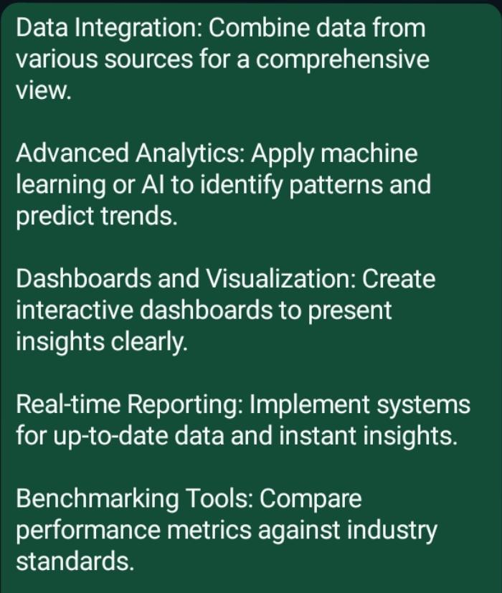
OUR SOLUTION AND ITS VALUE PROPOSITION

Slide 8
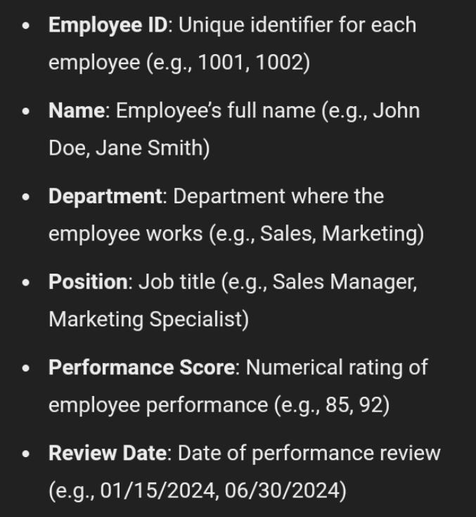
Dataset Description

Slide 9

THE "WOW" IN OUR SOLUTION
Advanced Filtering and Sorting
Dashboard creation
Trend analysis
Employee segmentation
Correlation analysis
3/21/2024 Annual Review
9

Slide 10
MODELLING
10

Slide 11
RESULTS
11

Slide 12
conclusion

